Slide 1
CHAPTER 5: Combinational Logic Circuit Design

Slide 2
Syllabus
Week | Content | Notes
1 | Chapter 0: Course Introduction (1) Chapter 1: Introduction to Digital Design (2)
2 | Chapter 2: Overview of HDL (3)
3 | Chapter 3: Basic Language Constructs of VHDL (3)
5, 6 | Chapter 4: Signal Assignment Statements of VHDL (6)
6 | Chapter 5: Combinational Logic Circuit Design (3)
7 | Midterm Exam (2)
8 | Chapter 6: Sequential Logic Circuit Design (3)
9, 10 | Chapter 7: Finite State Machine (FSM) Principle (6)

Slide 3
Content
Derivation of Efficient HDL Description
Operation Sharing
Functionality Sharing
Layout-related Circuits
General Circuits
Problems

Slide 4
1. Derivation of Efficient HDL Description
Although the appearance of VHDL code is very different from a schematic diagram, VHDL code is just another way to describe a circuit.
Synthesis software carriers out a series of refinements and transforms a textual VHDL description to a cell-level netlist.
Although software can perform simplification and local optimization, it does not know the meaning or intention of the code and cannot exploit alternative designs or change the architectural of the circuit.
The quality of a design and its description are two independent factors.

Slide 5
1. Derivation of Efficient HDL Description
Derivation of an efficient, synthesizable VHDL description requires two major tasks:
  Research to find an efficient design
  Develop VHDL code that accurately describes the design.
For a problem in digital system development, there is seldom a single unique solution.

Slide 6
2. Operator Sharing
When a VHDL program is synthesized, all statements and language constructs of the program will be mapped to hardware.
One way to reduce the overall size of synthesized hardware is to identify the resources that can be used by different operations.
This is known as resource sharing.

Slide 7
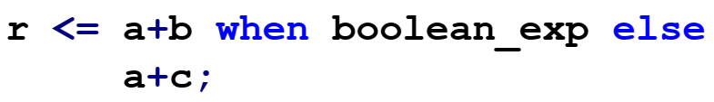
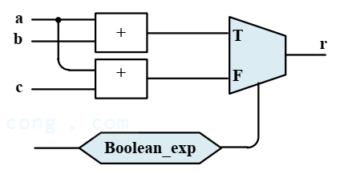
2. Operator Sharing
Consider the following code segment:
The block diagram of this code is shown as
  There are two adders and one multiplexers

Slide 8
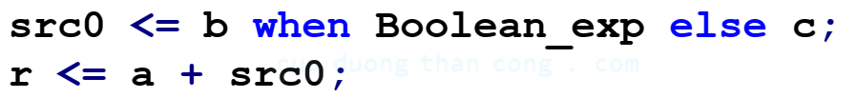
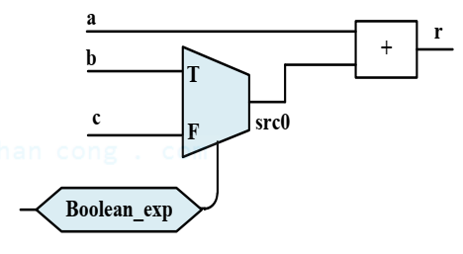
2. Operator Sharing
The adder can be shared because only one additional operation is needed at any time.
We can revise the code as follows:
One adder can be eliminated in this new implementation

Slide 9
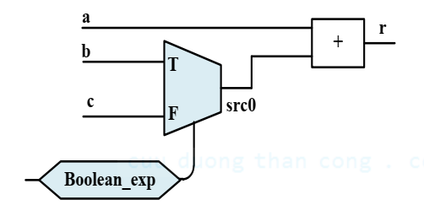
2. Operator Sharing
Now we compare the propagation delays of the two circuits.
In the first circuit, the adders and Boolean-exp operate in parallel.
In the second circuit, the adders, Boolean-exp operate, and the adder in sequential.
$$T_{total}=T_{boolean}+T_{mux}+T_{adder}$$
$$T_{total}=\max\left(T_{adder},T_{boolean}\right)+T_mux$$

Slide 10
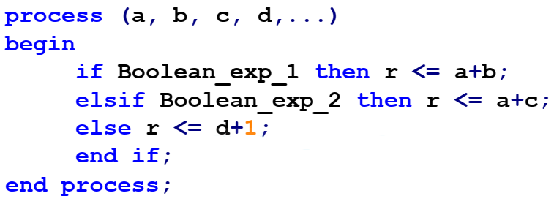
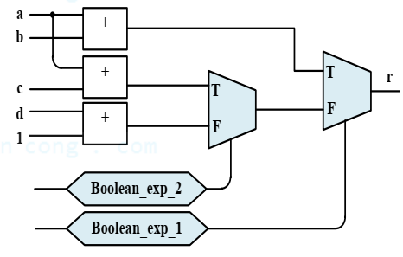
2. Operator Sharing
Consider the following code segment
The implement needs:
  Two adders
  One incrementor
  Two multiplexers

Slide 11
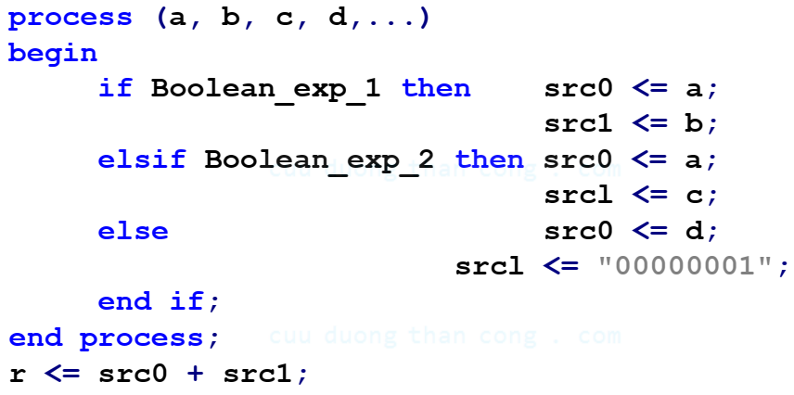
2. Operator Sharing
The revised code becomes

Slide 12
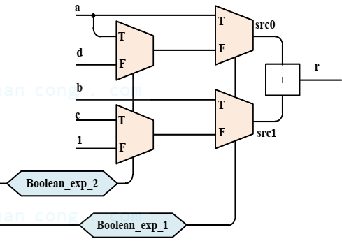
2. Operator Sharing
The block diagram of the new code is shown as.
We use two multiplexers to route the desired to the inputs of the adder.
The new circuit eliminate one adder and one incrementor but requires two additional multiplexers.
To determine whether the sharing is better, we examine the circuit size of the adder, incrementor and multiplexer.

Slide 13
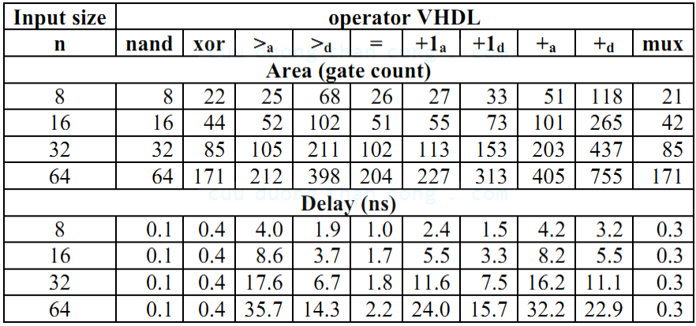
2. Operator Sharing
Since a multiplexer is smaller, especially when compared with an adder, the sharing indeed leads to a smaller size.

Slide 14
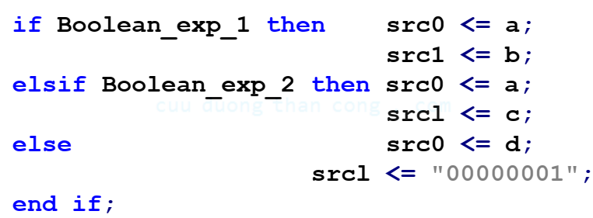
2. Operator Sharing
It is likely that the multiplexing circuit can be further simplified during logic synthesis, due to the duplicated input patterns (the ‘a’ signal is used twice) and constant input (“00000001”).
The saving will become more significant if a high-performance adder (the one optimized for delay) is used.

Slide 15
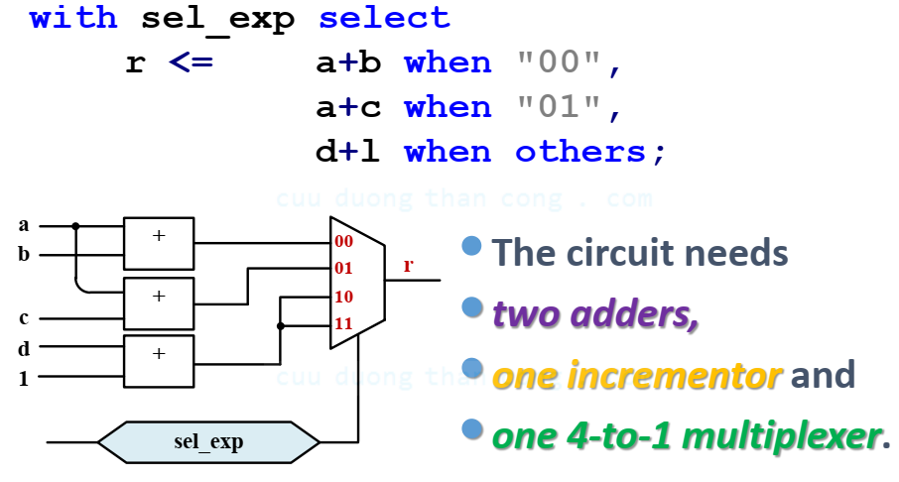
2. Operator Sharing
Consider the following code segment

Slide 16
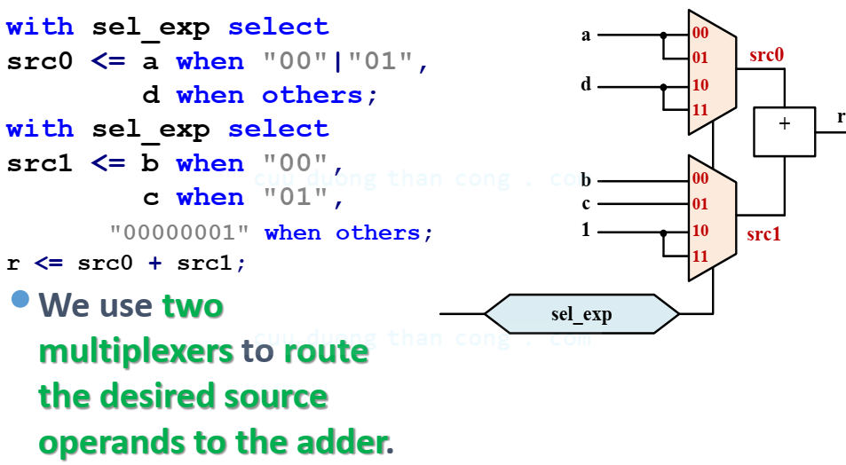
2. Operator Sharing
We can revise the code to share the adder

Slide 17
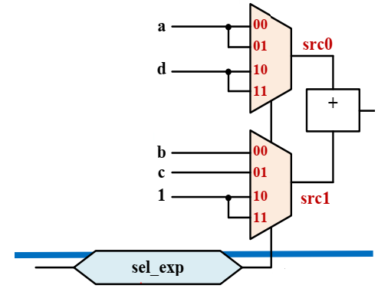
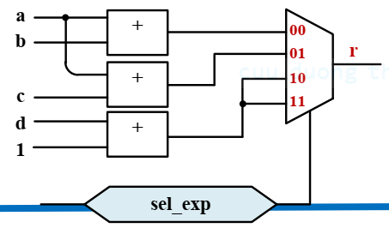
2. Operator Sharing
The new circuit eliminates one adder and one incrementor but requires an additional 4-to-1 multiplexer.
Since an adder and an incrementor are more complex than a multiplexer, the revision leads to a signification saving.

Slide 18
3. Functionality Sharing
In a large, complex digital system, such as a processor, an array of functions is needed.
Some functions may be related and have certain common characteristics.
It is possible for several functions to share a common circuit or to utilize one function to construct another function.
We call this approach as functionality sharing.
It is more difficult for synthesis software to identify functionality sharing.

Slide 19
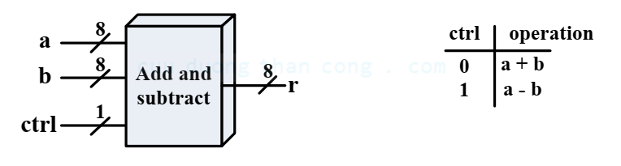
3. Functionality Sharing
Consider a simple arithmetic circuit that performs either addition or subtraction.
A control signal, ctrl, specifies the desired operation.
The function table of this circuit is shown as
Our first design follows the function table and the VHDL code is very straightforward.

Slide 20
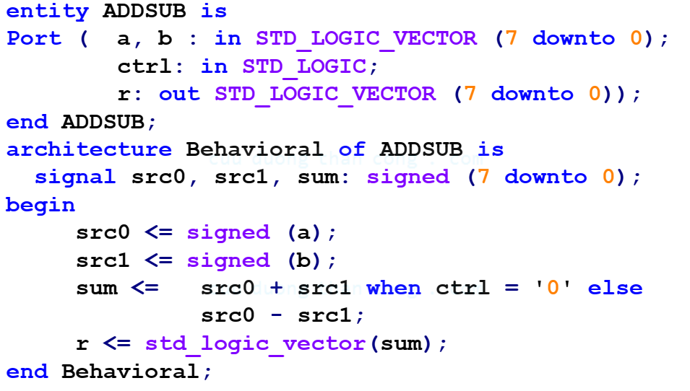
3. Functionality Sharing

Slide 21
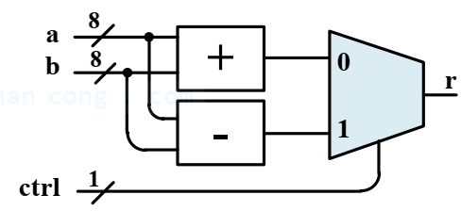
3. Functionality Sharing
The conceptual diagram for this code is shown.
The diagram includes
  An adder
  A subtractor
  A 2-to-1 multiplexer

Slide 22

3. Functionality Sharing
In 2’s-complement representation, recall that the subtraction, a-b, can be calculated as
Therefore, it is possible to share the functionality of the adder

Slide 23
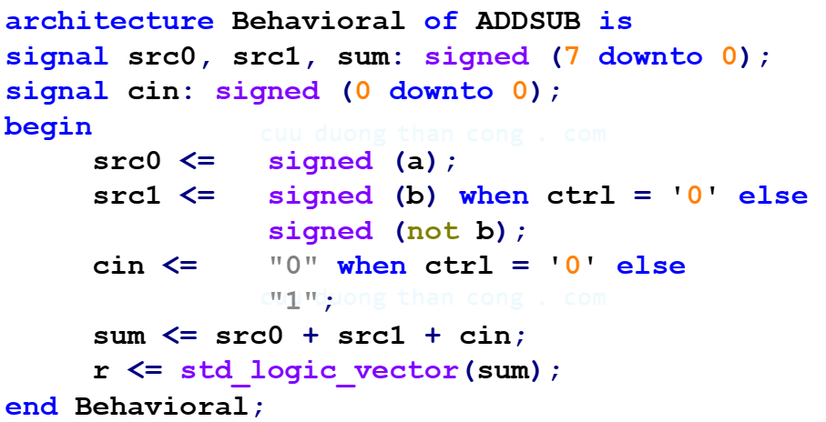
3. Functionality Sharing

Slide 24
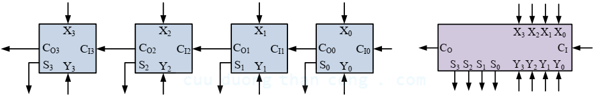
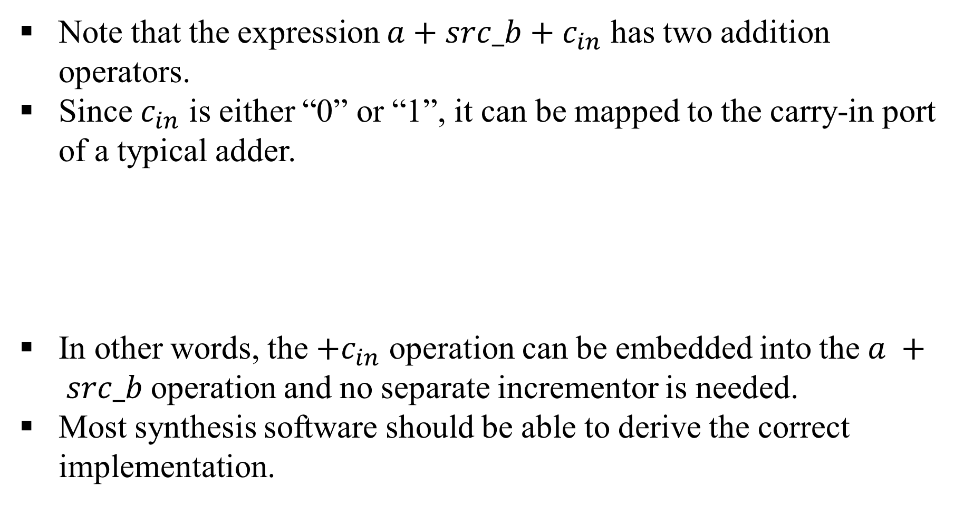
3. Functionality Sharing
Note that the expression $a+src_b+c_{in}$ has two addition operators.
Since $c_{in}$ is either “0” or “1”, it can be mapped to the carry-in port of a typical adder.
In other words, the $+c_{in}$ operation can be embedded into the $a + src_b$operation and no separate incrementor is needed.
Most synthesis software should be able to derive the correct implementation.

Slide 25
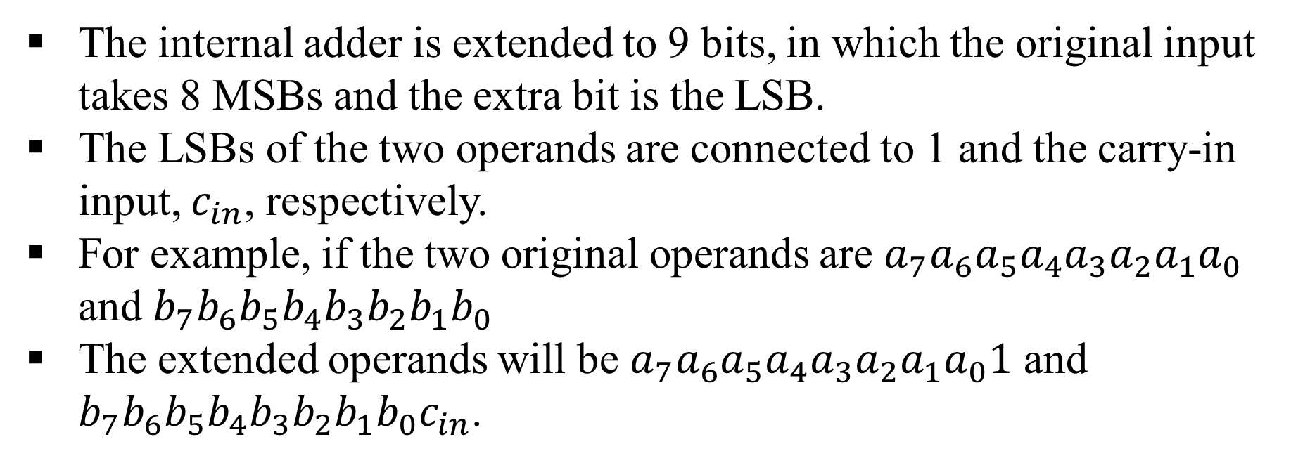
3. Functionality Sharing
The internal adder is extended to 9 bits, in which the original input takes 8 MSBs and the extra bit is the LSB.
The LSBs of the two operands are connected to 1 and the carry-in input, $c_{in}$, respectively.
For example, if the two original operands are $a_{7}a_{6}a_{5}a_{4}a_{3}a_{2}a_{1}a_{0}$ and $b_{7}b_{6}b_{5}b_{4}b_{3}b_{2}b_{1}b_{0}$
The extended operands will be $a_{7}a_{6}a_{5}a_{4}a_{3}a_{2}a_{1}a_{0}1$ and $b_{7}b_{6}b_{5}b_{4}b_{3}b_{2}b_{1}b_{0}c_{in}$.

Slide 26
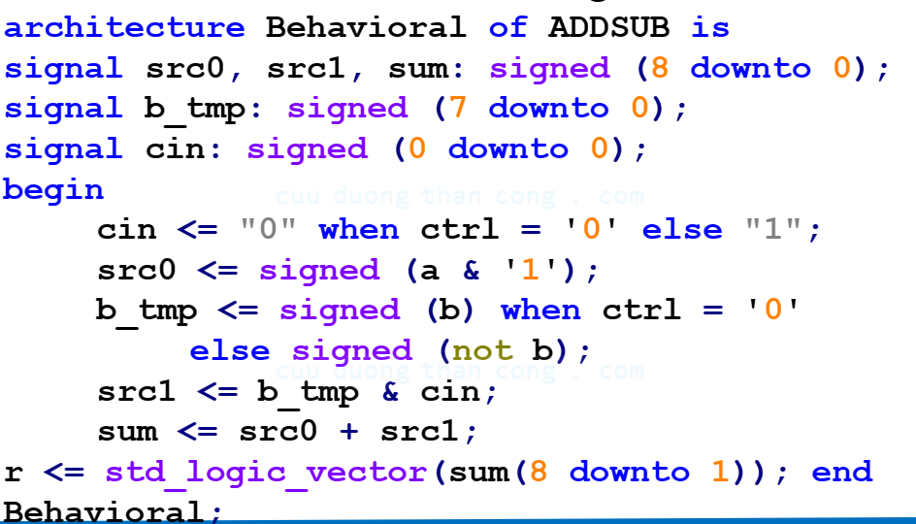
3. Functionality Sharing
The VHDL code of this design is

Slide 27
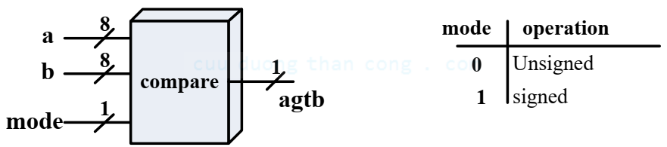
3. Functionality Sharing
Consider an example of signed-unsigned dual-mode comparator circuit.
This example considers a greater-than comparator in which the input can be interpreted as either unsigned or signed.
The input data type is specified by a control signal, mode.
Our first design uses two comparators, one for each data type, and then uses the mode signal to select the desired result.

Slide 28
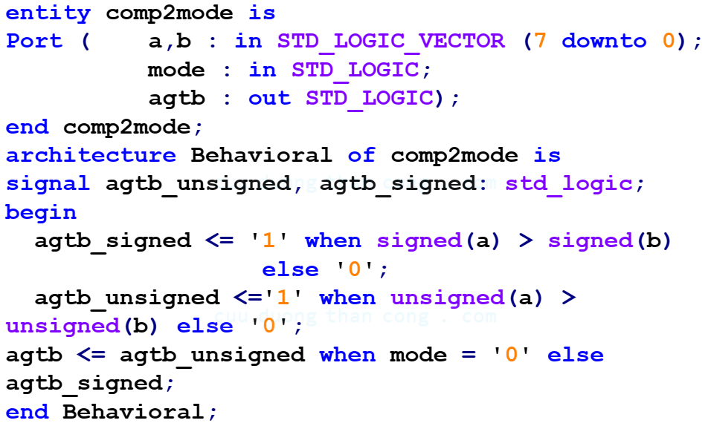
3. Functionality Sharing
The VHDL code of this design is

Slide 29
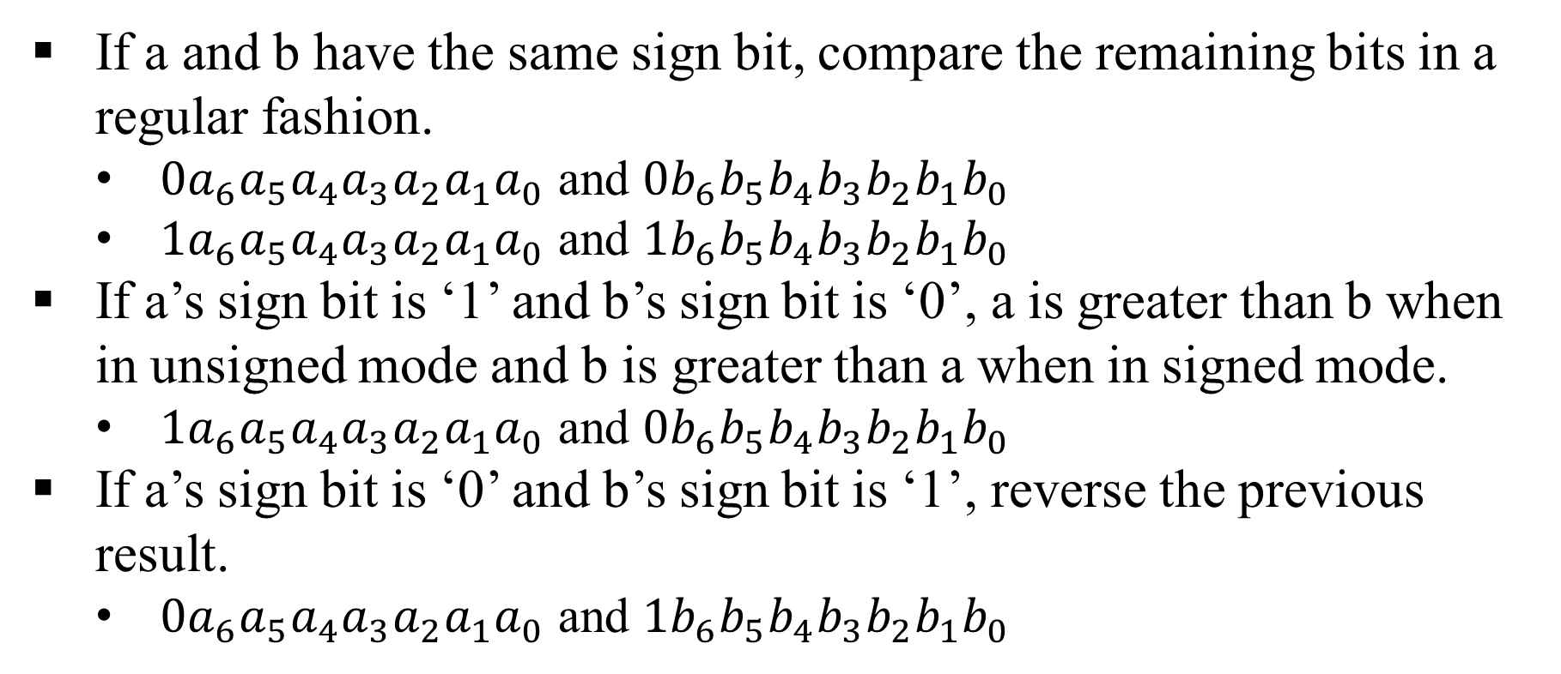
3. Functionality Sharing
If a and b have the same sign bit, compare the remaining bits in a regular fashion.
  $0a_{6}a_{5}a_{4}a_{3}a_{2}a_{1}a_{0}$ and $0b_{6}b_{5}b_{4}b_{3}b_{2}b_{1}b_{0}$
  $1a_{6}a_{5}a_{4}a_{3}a_{2}a_{1}a_{0}$ and $1b_{6}b_{5}b_{4}b_{3}b_{2}b_{1}b_{0}$
If a’s sign bit is ‘1’ and b’s sign bit is ‘0’, a is greater than b when in unsigned mode and b is greater than a when in signed mode.
  $1a_{6}a_{5}a_{4}a_{3}a_{2}a_{1}a_{0}$ and $0b_{6}b_{5}b_{4}b_{3}b_{2}b_{1}b_{0}$
If a’s sign bit is ‘0’ and b’s sign bit is ‘1’, reverse the previous result.
  $0a_{6}a_{5}a_{4}a_{3}a_{2}a_{1}a_{0}$ and $1b_{6}b_{5}b_{4}b_{3}b_{2}b_{1}b_{0}$

Slide 30
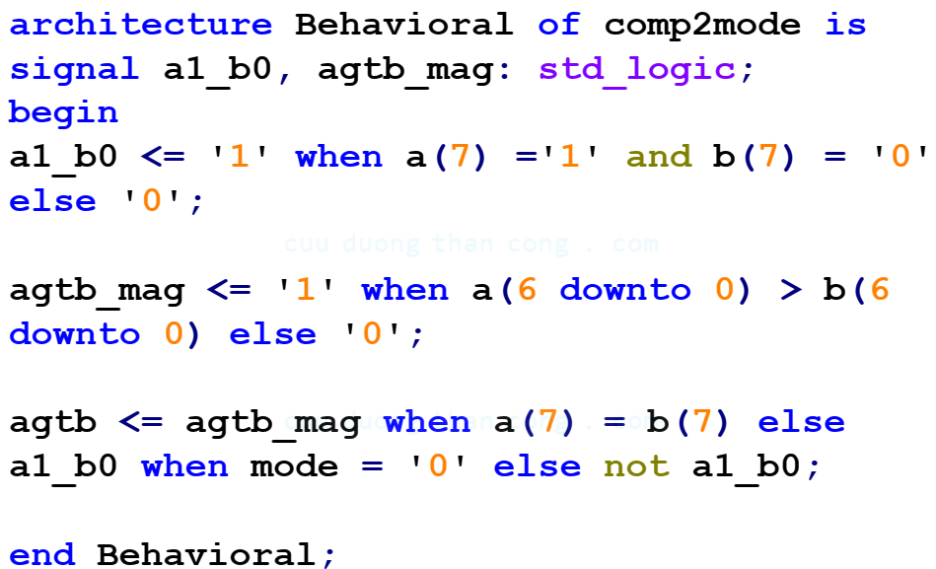
3. Functionality Sharing
The VHDL code of this design is

Slide 31
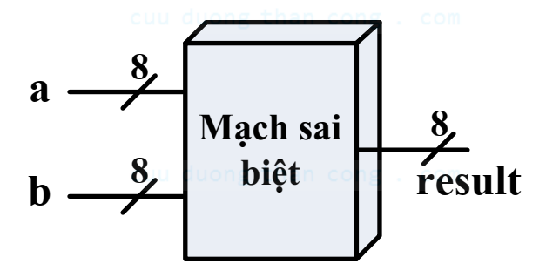
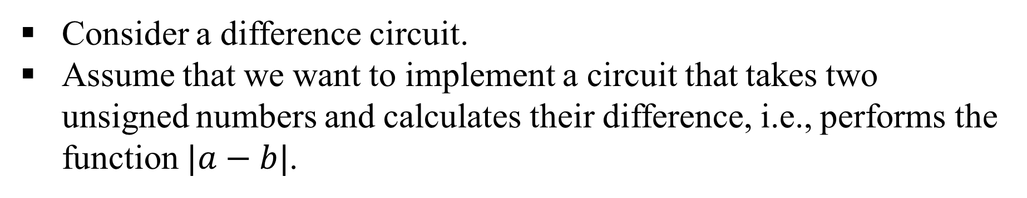
3. Functionality Sharing
Consider a difference circuit.
Assume that we want to implement a circuit that takes two unsigned numbers and calculates their difference, i.e., performs the function $|a−b|$.

Slide 32
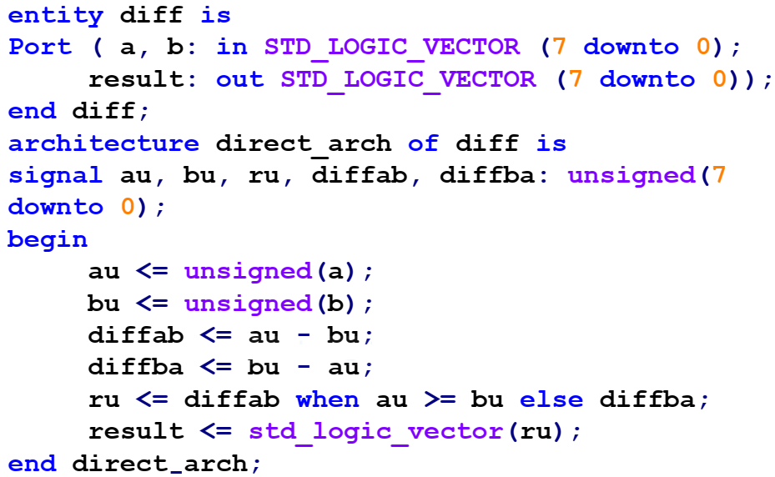
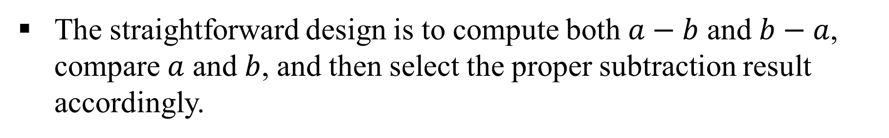
3. Functionality Sharing
The straightforward design is to compute both $a−b$ and $b−a$, compare $a$ and $b$, and then select the proper subtraction result accordingly.

Slide 33
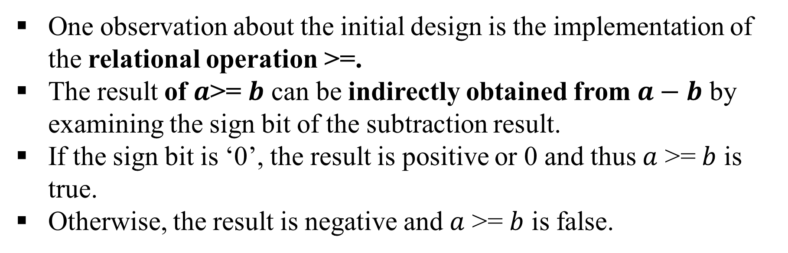
3. Functionality Sharing
One observation about the initial design is the implementation of the relational operation >=.
The result of $a$>= $b$ can be indirectly obtained from $a−b$ by examining the sign bit of the subtraction result.
If the sign bit is ‘0’, the result is positive or 0 and thus $a$ >= $b$ is true.
Otherwise, the result is negative and $a$ >= $b$ is false.

Slide 34
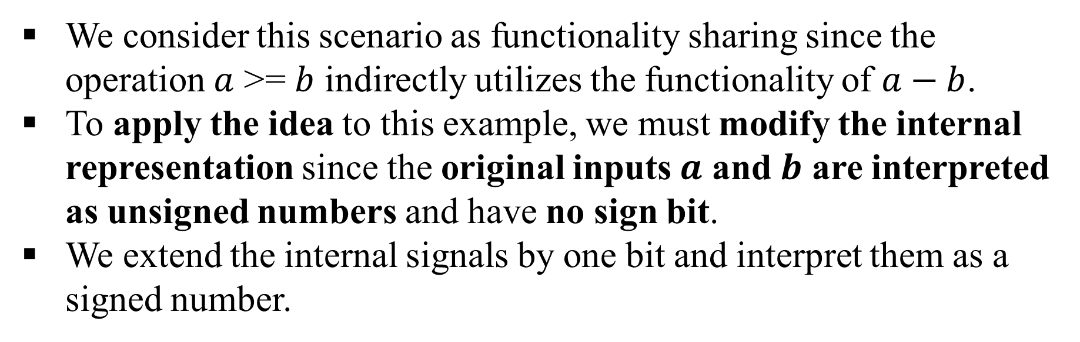
3. Functionality Sharing
We consider this scenario as functionality sharing since the operation $a$ >= $b$ indirectly utilizes the functionality of $a−b$.
To apply the idea to this example, we must modify the internal representation since the original inputs $a$ and $b$ are interpreted as unsigned numbers and have no sign bit.
We extend the internal signals by one bit and interpret them as a signed number.

Slide 35
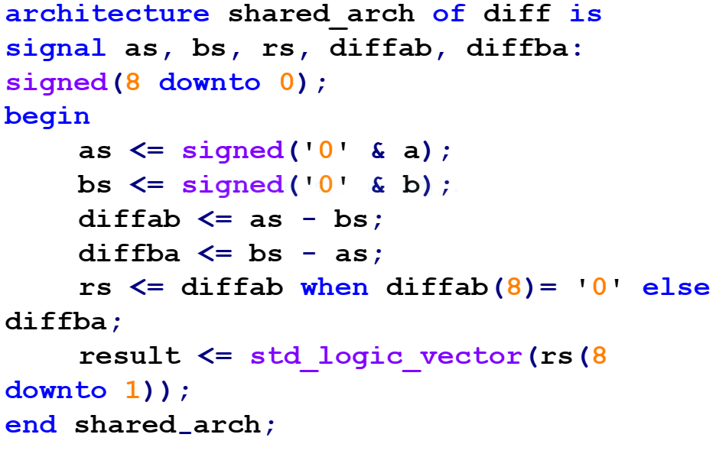
3. Functionality Sharing

Slide 36
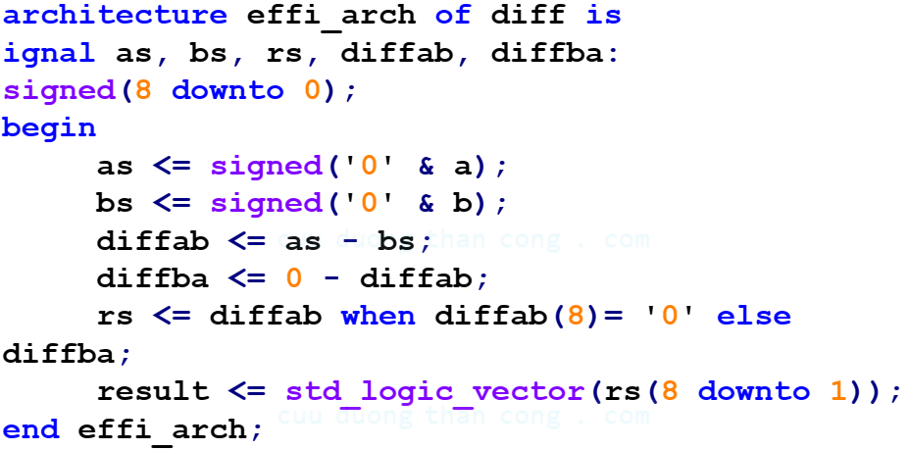
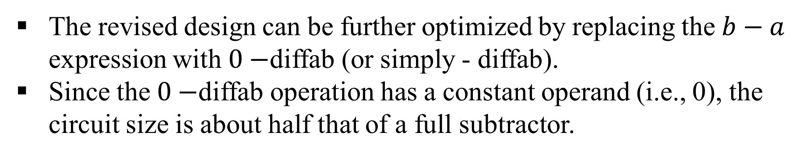
3. Functionality Sharing
The revised design can be further optimized by replacing the $b−a$ expression with $0−$diffab (or simply - diffab).
Since the $0−$diffab operation has a constant operand (i.e., 0), the circuit size is about half that of a full subtractor.

Slide 37
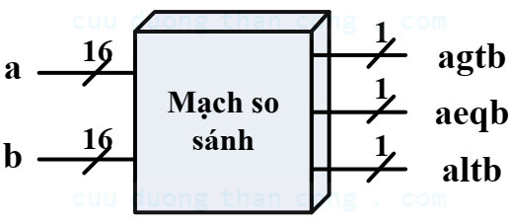
3. Functionality Sharing
Example: Full Comparator
Assume that we need a comparator that has three outputs, indicating the greater-than, equal-to and less-than conditions respectively.

Slide 38
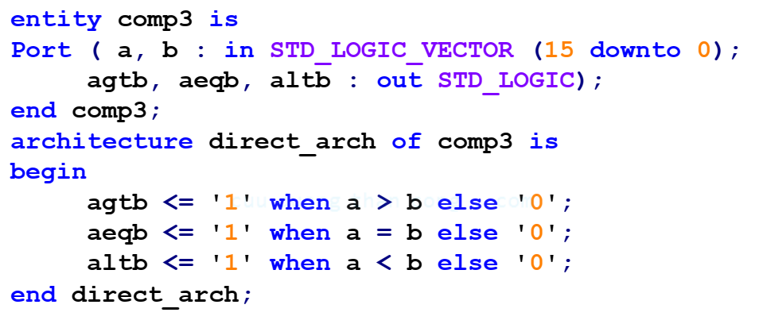
3. Functionality Sharing

Slide 39
3. Functionality Sharing
If we examine the three operations carefully, we can see that the three conditions are mutually exclusive, and the third one can be derived if the other two are known.
Thus, the functionality of the first two relational circuits can be shared to obtain the third output.

Slide 40
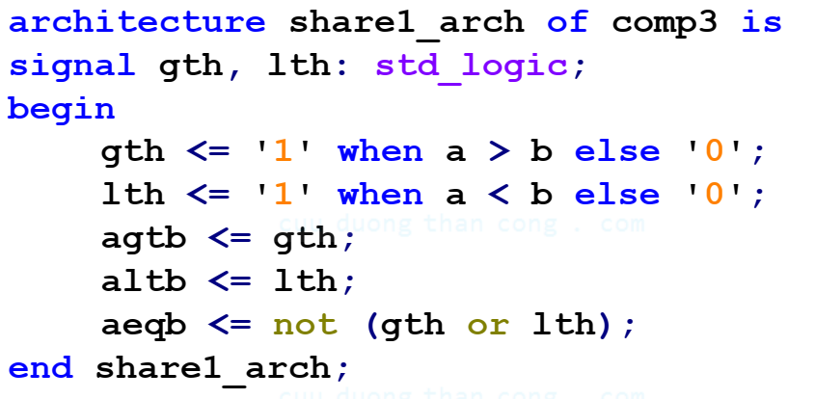
3. Functionality Sharing

Slide 41
3. Functionality Sharing
If we look Area and Delay table, the equal-to circuit is smaller and faster than the greater-than circuit (especially compared with the circuit optimized for delay).
We can further optimize the circuit by using the equal-to operator either the greater-than or less-than operator.

Slide 42
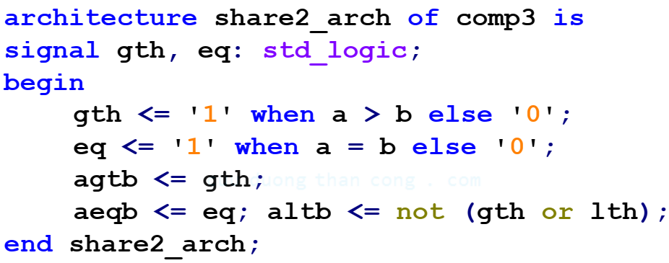
3. Functionality Sharing

Slide 43
3. Functionality Sharing
Example: Three-function barrel shifter
A barrel shifter is a circuit that can shift input data by any number of positions.
Shifting operations can be done in either the left or right direction and are divided into rotate, logic shift and arithmetic shift.

Slide 44
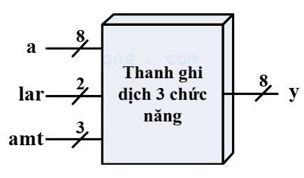
3. Functionality Sharing
In addition to the 8-bit data input, this circuit has a control signal, lar (for logic shift, arithmetic shift and rotate), which specifies the operation to be performed, and a control signal, amt (for amount), which specifies the number of positions to be rotated or shifted.

Slide 45
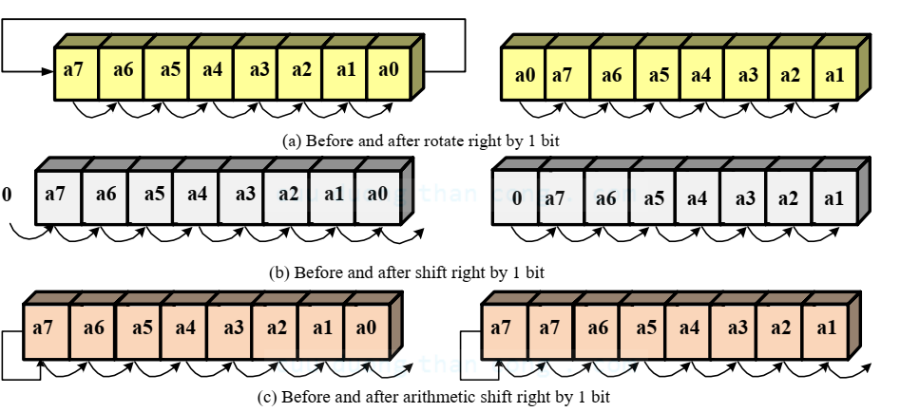
3. Functionality Sharing

Slide 46
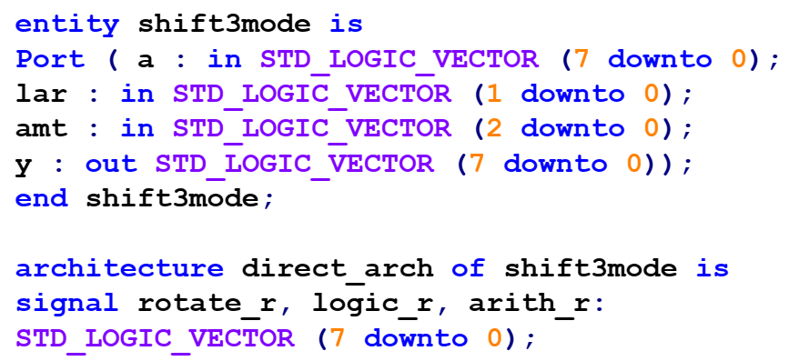
3. Functionality Sharing

Slide 47
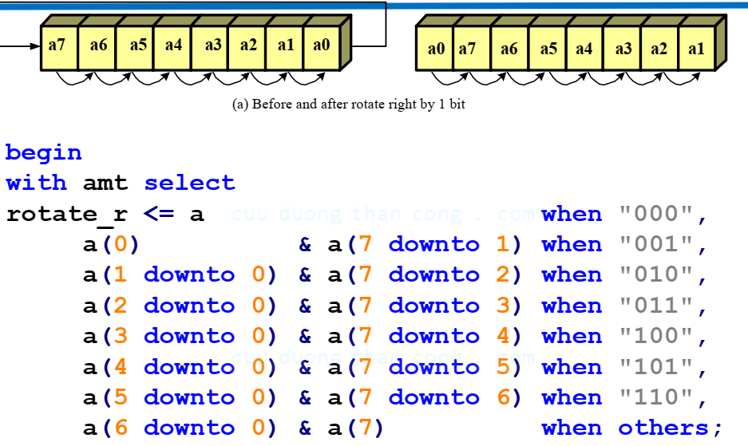
3. Functionality Sharing

Slide 48
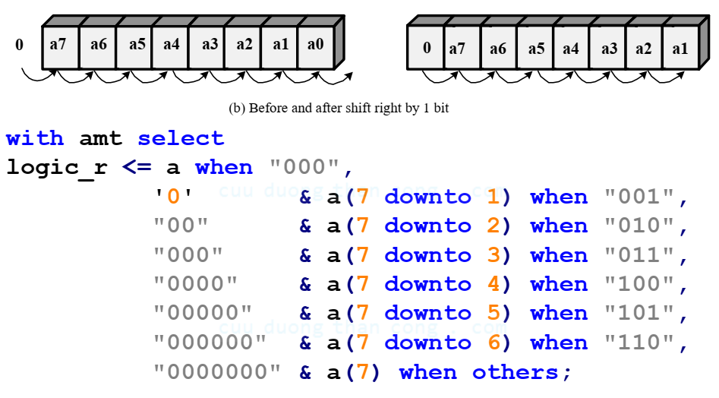
3. Functionality Sharing

Slide 49
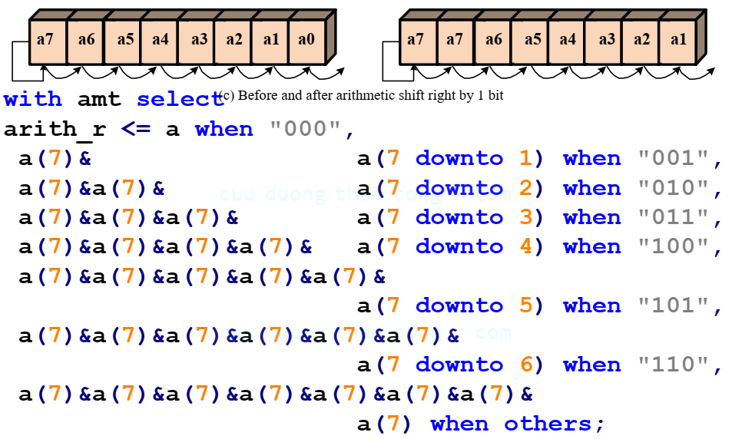
3. Functionality Sharing

Slide 50
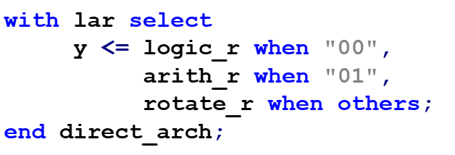
3. Functionality Sharing

Slide 51
3. Functionality Sharing
The implementation includes three 8-bit 8-to-1 multiplexers and one 8-bit 3-to-1 multiplexer.
If we examine the output of three shifting operations, we can see that their patterns are very similar and the only difference is the data being shifted into the left part.
It is possible to share the functionality of a shifting circuit.

Slide 52
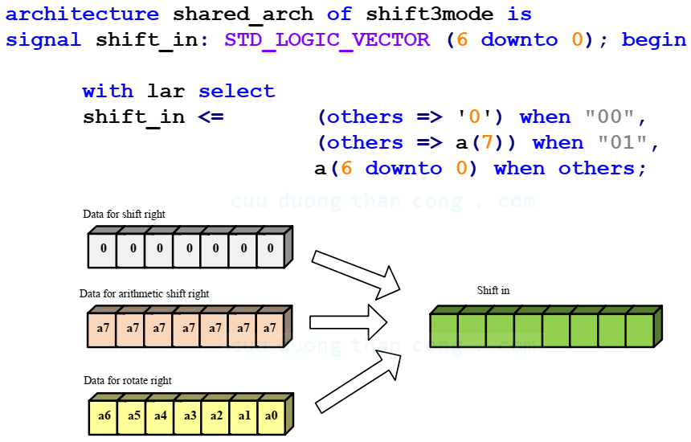
3. Functionality Sharing

Slide 53
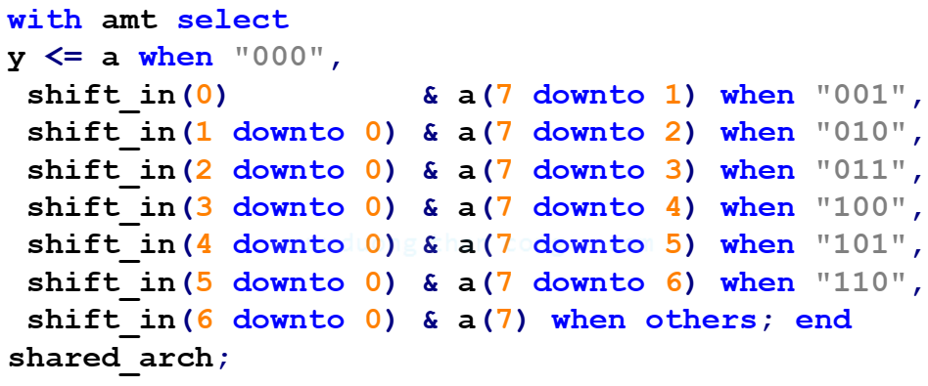
3. Functionality Sharing

